Slide 1
Collective Intelligence Brood sorting
Xiang Linyun
kovacsszilard@inf.elte.hu

Slide 2
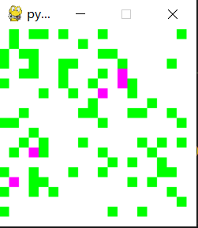
Example Project
Task
Multi-agents are doing the food sorting, the green cells present food, and the pinks are agent
Goal
The agents are required to sort the food together as much as possible
Image(s)

Slide 3
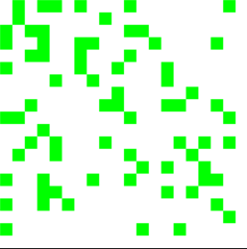
Environment
2D Enviroment
With 400x400 pixel
Each individual block is 20x20
Each green cell present a food
Image(s)

Slide 4
Observation spaces(density calculation)
5 * 5 grid observation space
See the agent position as the central point, counting how many food points are connected by the central point(diagonally as well)
The connected number of the example on the side is 6

Slide 5
Observation spaces(also use as state space)
The observation space is a combination of three values
Density (see the previous slide)
Dose the agent carry food
Dose the agent 'current location has food
Density | Agent’s state | Agent’s current location state
0(connection = 0) | 0(No food) | 0(No food)
1(0<connection<=2) | 1(carrying food) | 1(has food)
1(2<connection<=4)
2(4<connection<=10)
4(10<connection<=25)

Slide 6
Action spaces
Random moving
Up
Down
Left
right
Pick up
Put down
Random moving

Slide 7
Models and Policies
Model
Random action
Epsilon-Greedy(with decay)
Policy
Q-learning

Slide 8
Rewards
Positive
When agent puts down or picks up according to the density calculation function
0
when agent moving around
Negative(-1)
If the agent picks up when it’s carrying
If the agent puts down when it’s not carrying

Slide 9
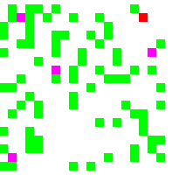
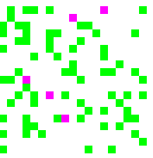
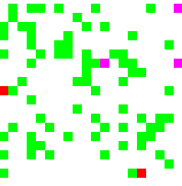
Results Test/Sorting states

Slide 10
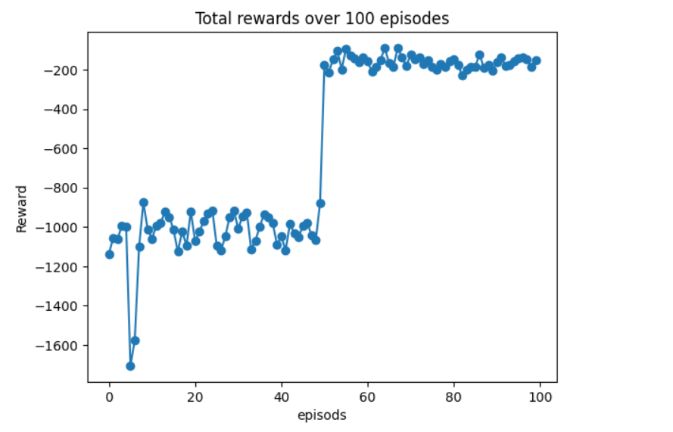
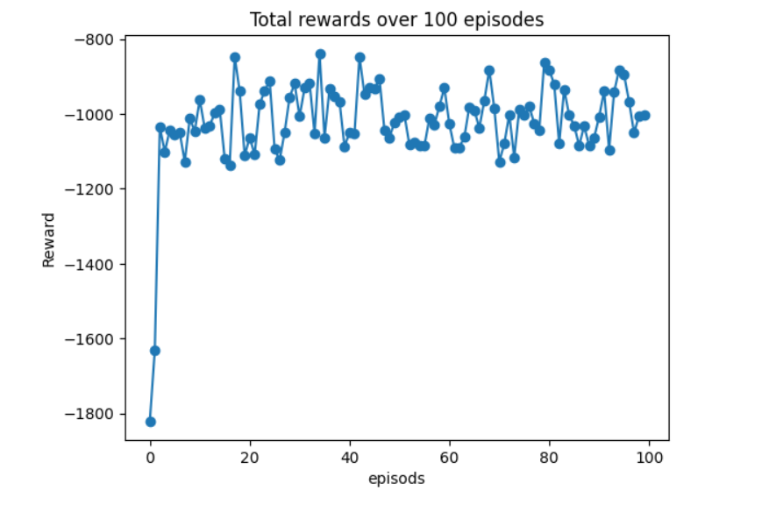
Results Test
Learning rate = 0.1
Learning rate = 0.01

Slide 11
Conclusion and Further Work Example
Conclusion
It is easy to stuck in local minimum
The model is quite noise, it could learn better with more state spaces
Further Work
Hyperparameter search
Learning rete, epsilon
Hybrid RL model

Slide 12
Thank You for Your attention!
Xiang Linyun
G60WFG@inf.elte.hu
Questions?

